Slide 1

NON – LINEAR REGRESSION MODEL
PROJECT REPORT ON POLYNOMIAL REGRESSION

Slide 2
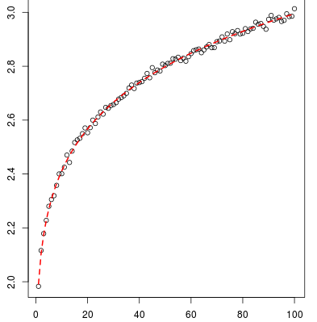
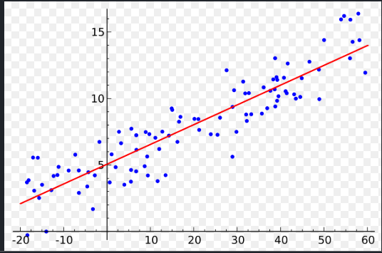
TYPES OF REGRESSION
LINEAR REGRESSION
NON-LINEAR REGRESSION

Slide 3
Non-Linear regression
TYPES OF NON – LINEAR REGRESSIONS
POLYNOMIAL REGRESSION
QUADRATIC REGRESSION
LOG REGRESSION
LOG – LOG REGRESSION

Slide 4
POLYNOMIAL REGRESSION
In statistics, it is a form of regression analysis in which the relationship between the independent variable x and the dependent variable y is modelled as an nth degree polynomial in x.
So it looks like Y = ax + b it is equation of degree 1
Where a is the slope and b is the y intercept
The nth degree equation looks like
If the equation is of degree 2 then it is considered as QUADRATIC
REGRESSION

Slide 5






Correlation Function
If x, y are two random variables than it is defined by
r( x, y) = covariance (x,y)/sqrt(variance(x))sqrt(variance(y))
$$\frac{1}{n}\sum_{i=1}^{n}{x}y−\overline{x}\overline{y}$$
Co varience (x, y) =
Where
$\overline{x}$ = $\sum_{i=1}^{n}{xi}$
$\overline{x}$, $\overline{y}$ are means
Variance (x) = $\frac{1}{n−1}\sum_{i=1}^{n}{{\left(x_{i}−\overline{x}\right)}^{2}}$
$$\overline{y}=\frac{1}{n}\overline{\sum_{i=1}^{n}{yi}}$$
Variance (y) = $\frac{1}{n−1}\sum_{i=1}^{n}{{\left(y_{i}−\overline{y}\right)}^{2}}$

Slide 6
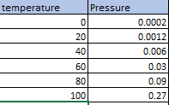
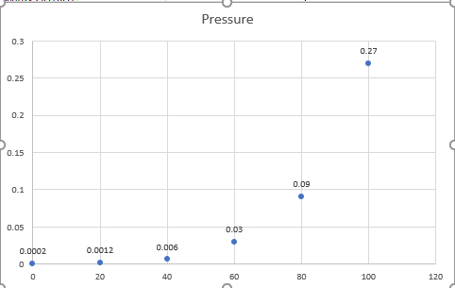
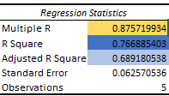
DATA ANALYSIS USING POLYNOMIAL REGRESSION MODEL
GIVEN DATA
OBESEVE THE DATA USING SCATTER PLOT
CORRELATION FUNCTION VALUES
In the data dependent variable y is pressure and independent variable x is temperature
IT LOOKS LIKE
THE R SQUARE VALUES FOR THE GIVEN
DATA IS SHOWN BELOW
Regression Statistics
Multiple R
0.875719934
R Square
0.766885403
Adjusted R Square
0.689180538
Standard Error
0.0625705
36
The correlation function R square values shows 76 percent

Slide 7
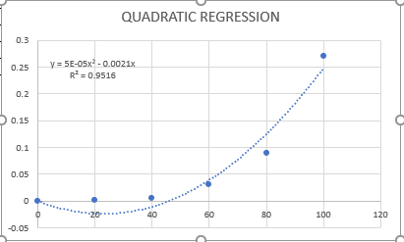
QUADRATIC REGRESSION MODEL
The correlation function R square value shows 95%. So
It is better than polynomial regression with order 1
In the polynomial regression model of order 1, the correlation function R square value is showing 76 % so it can predict 76 % correctly
So to increase the R square value we are using polynomial regression with order 2 i.e Quadratic Regression Model.

Slide 8
About the Plot of regression model
In Quadratic Regression Model the R square value can predict more accurately then the Polynomial Regression Model with degree 1
In the graph of degree 2 Regression Model shows the predicted values shown by the trend line followed by the points
The error values is the difference between actual points to the predicted points This difference is also called as Residual.

Slide 9
Polynomial Regression model with order 3
Again to improve correlation function value of R square
we are using the following model
The order is the power of x so the equation
Looks like y = ax3+bx2+cx+c

Slide 10
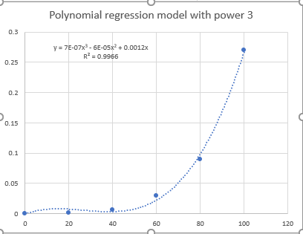
Polynomial regression with order 3
In this model the R square value is showing
99 percent accuracy so this is the best model than previous models .
The trend line is following the actual points
With minor error values.
So this the best fit model for predicting the future values .

Slide 11
Comparison of line fit plots
R Square = 76 %
R Square = 95 %
R Square = 99 %

Slide 12

By comparing the plots it clearly indicating that the polynomial regression model with
Order 3 is showing best correlation value than remaining models
Generally If the correlation function R (x, y) for any model if it is greater than 50 percent
than it Is consider as the better model
The accuracy of the prediction will depend on the correlation value

Slide 13


THANKING YOU

